Slide 1



Art of tourism organization

Slide 2
Art of tourism company was established in 1997 the owner of the company decided to develop the company from booking travel through offices to a website and cooperate with the system analysis company to help it .
Introduction

Slide 3

Our company consists of three subsystem
Management
Employees
Tourists
user categories: management, employee, tourists

Slide 4
functional requirements
Management subsystem
the system must serve managers by implementing the following functions :
- Put a discount on employee's salary
- View payment information of a tourist
- Give permission for leave
- View reports
- Set up a training program
- Promote an employee

Slide 5
functional requirements
Employees subsystem
employees should make use of the system by doing :
- Register new account
- Log in
- set up a tour program
- Enroll in training program
- response to customers inquiries
- request for leave
- log out

Slide 6
functional requirements
Tourists subsystem
the system will be responsible for :
- Register new account
- Log in
- View trips
- Booking a trip
- Pay fees
- print all information about trip and reservation
- Communicate with service customer employees.

Slide 7
DFD
( Data Flow Diagram )

Slide 8
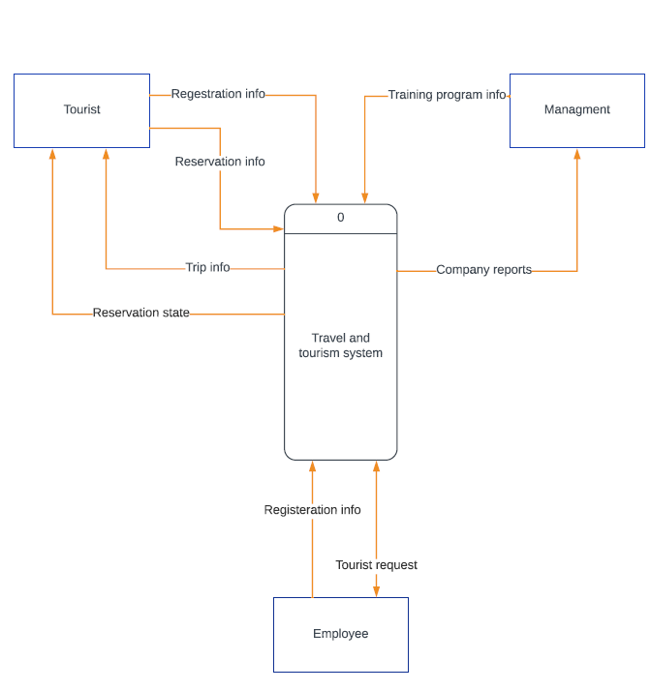
Context-Level diagram

Slide 9
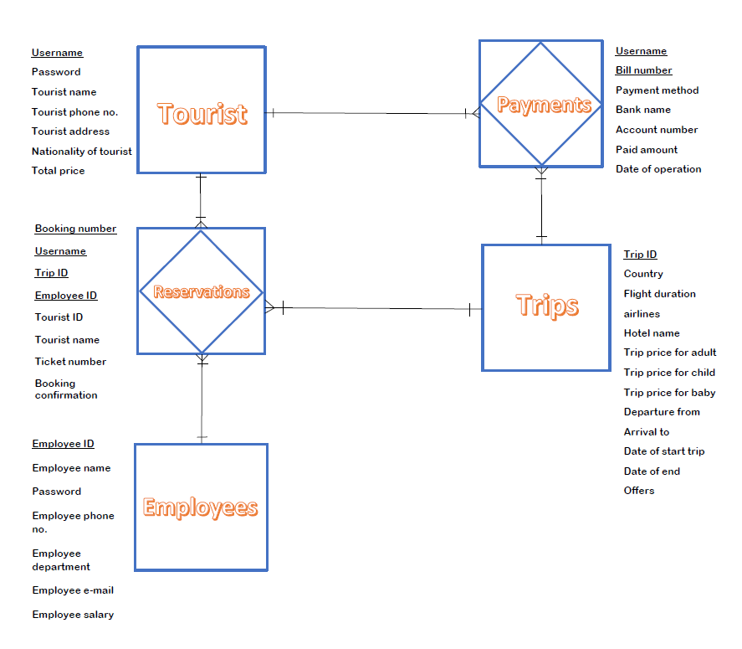
ERD (Entity relationship)

Slide 10
Use case
diagrams

Slide 11
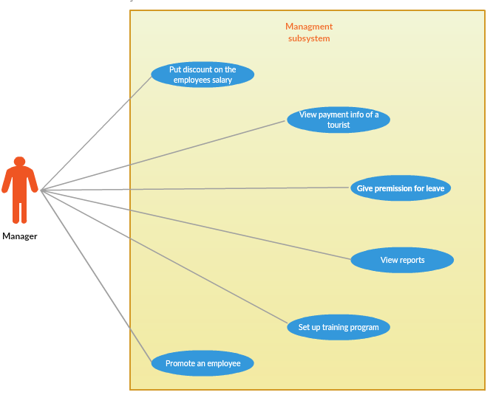
Management use case diagram

Slide 12
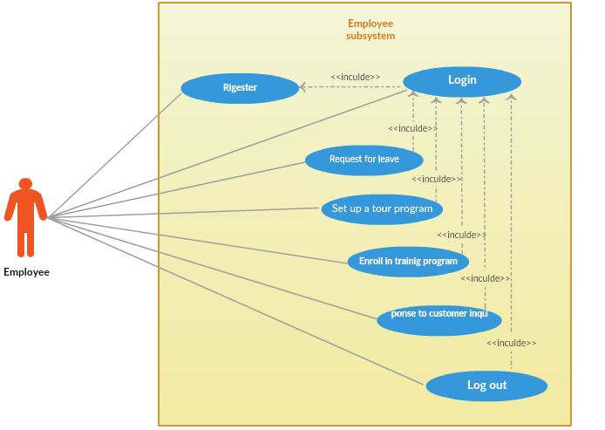
Employee use case diagram

Slide 13
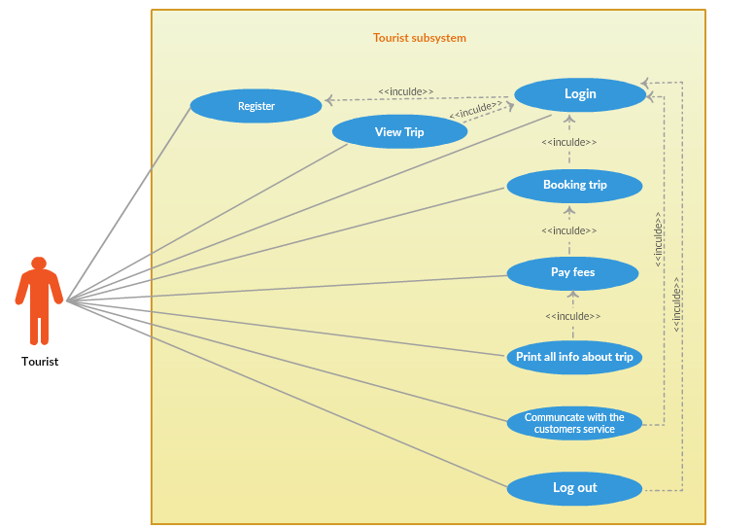
Tourist use case diagram

Slide 14
User interfaces

Slide 15
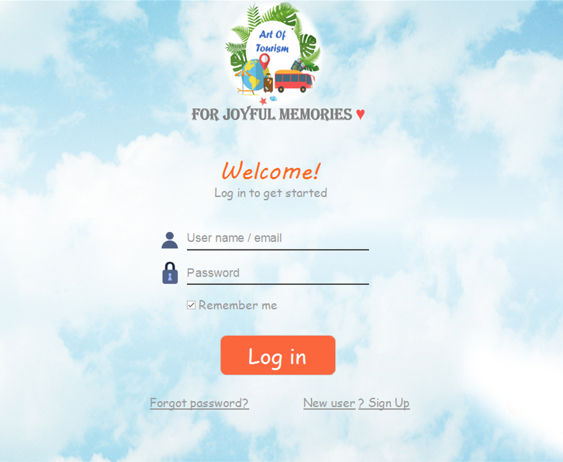
Log in interface (input interface)

Slide 16
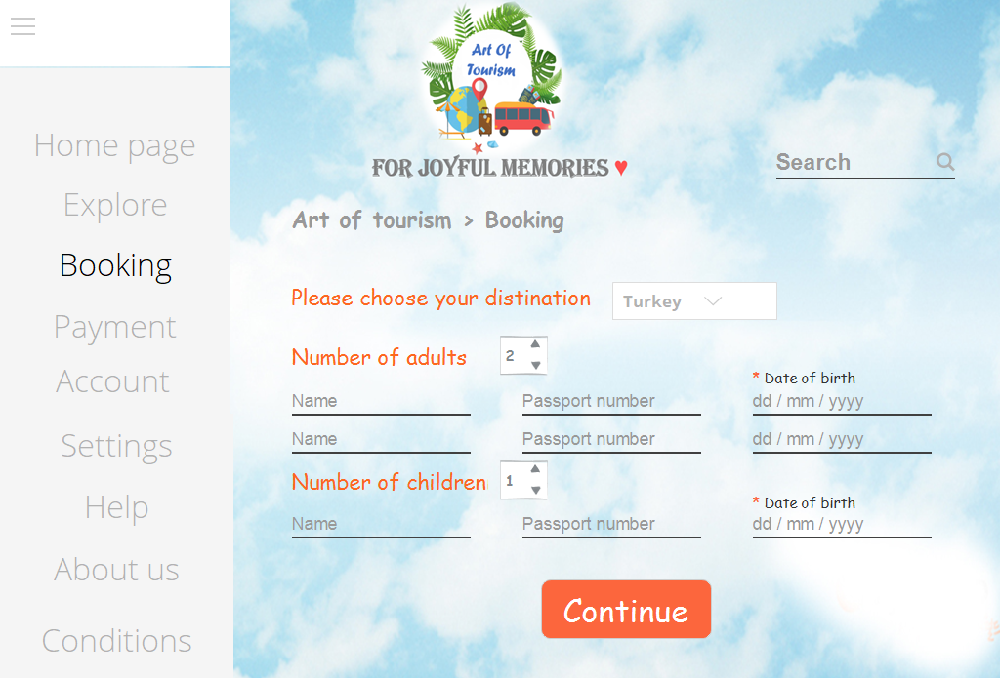
Booking interface (input interface)

Slide 17
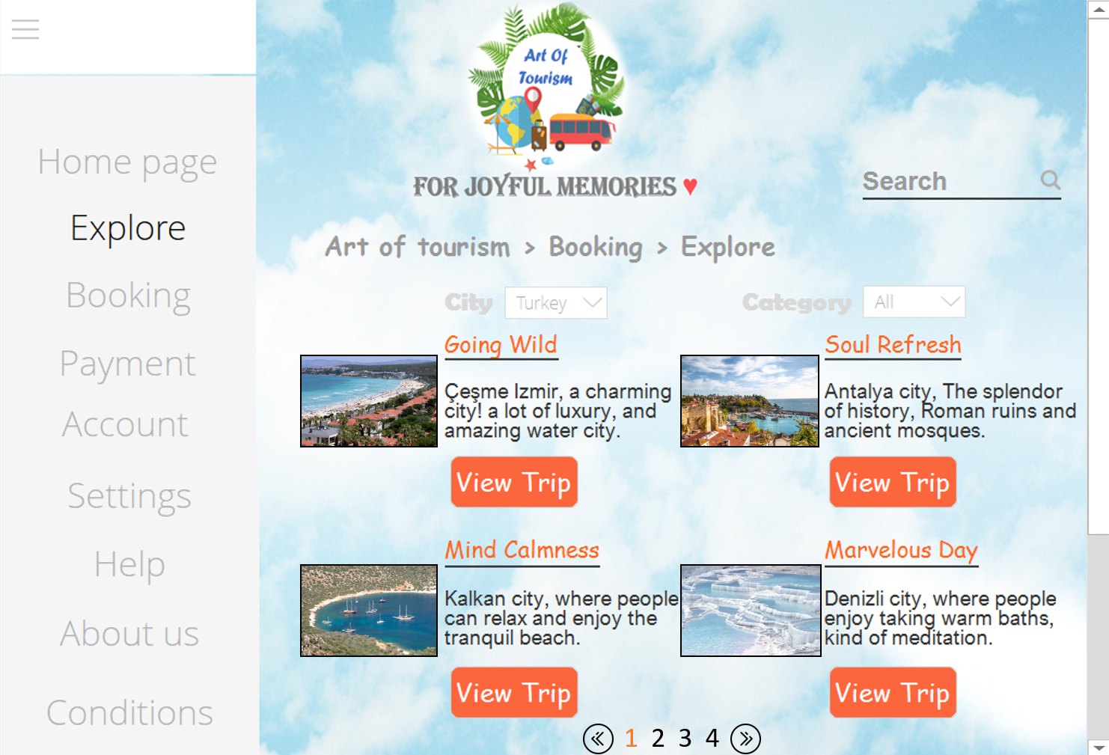
Explore interface (Output interface)

Slide 18
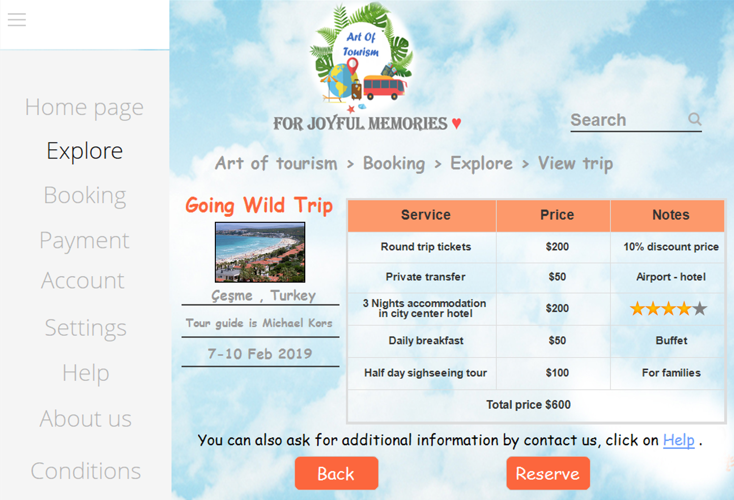
View trip interface (output interface)

Slide 19
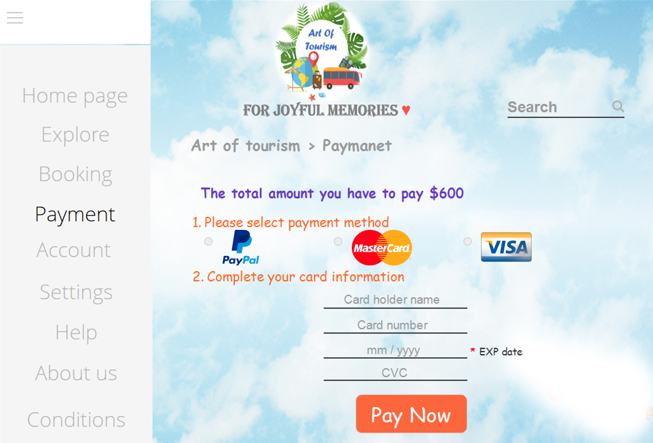
Payment interface (input interface)

Slide 20
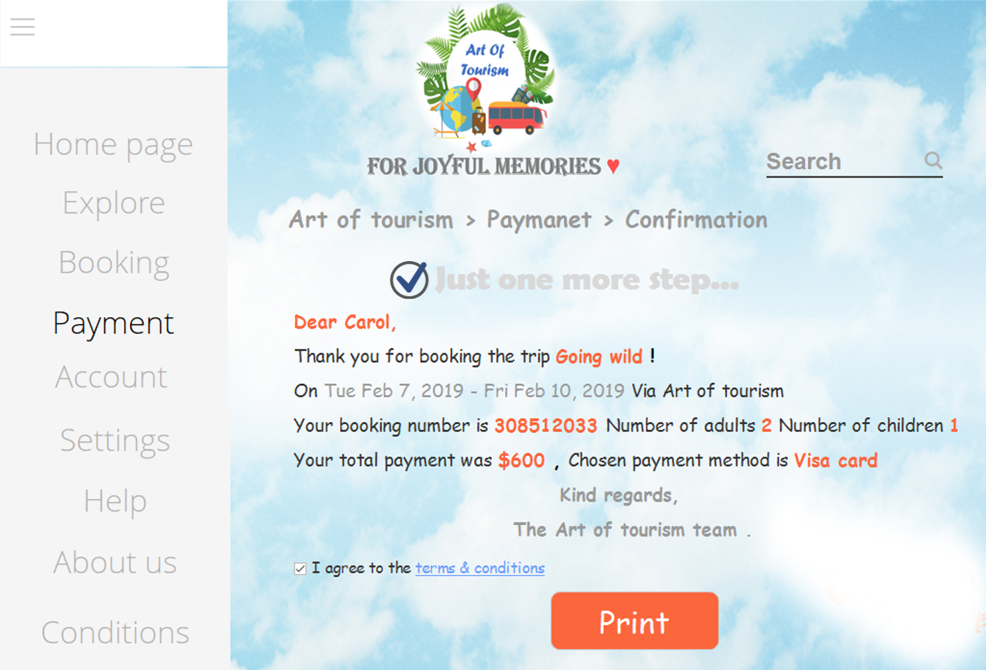
Print information about reservation (Output interface)

Slide 21
Supervisor Dr. Areej Alfraih this project prepared by Shoug mohammed Alwethnani group 1 Anoud Yahya Alghamdi group 2 Sarah bander Aldahas group 2 Khadija abdullrahman Bahshwan group 2 Tahani sulaiman Al-luhaibi group 3
First semester of 2018

